Slide 1
Optimal algorithms for experts and mixtures of Gaussians
Version of August 5, 2020
Chris Liaw
UBC, August 2020
Notes:
Thanks everyone for coming. Today, I’d like to tell you about some of the work that I have been doing over the course of my PhD.

Slide 2
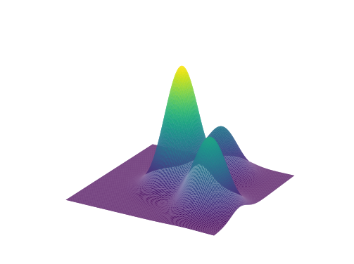
Research overview
Goal: Design & analyze machine learning algorithms with provable guarantees.
Prediction with expert advice
[HLPR, FOCS‘20]
Learning mixtures of Gaussians
[ABHLMP NeurIPS’18, JACM’20]
Notes:
Over the course of my PhD, a primary focus for me has been problems which are motivated by machine learning. And I’ve looked at a number of such problems ranging from better understanding gradient descent or neural networks.
For today, I will tell you about two projects which I am particularly proud of.
In the first half of my talk, I will tell you about the problem of prediction with expert advice. In particular, I will tell you how we used tools from stochastic calculus and PDEs to design the optimal algorithm when there are two experts.
In the second half of my talk, I will talk to you about the problem of learning mixtures of Gaussians. Here I will tell you about a new framework for learning distributions and show how we can apply it to learn mixtures of Gaussian with as few data points as possible.
Do I want to mention other stuff that I have worked on? E.g. the neural net stuff or the SGD stuff?
Research goal is to design and analyze machine learning algorithms that have provable guarantees.
Today, give a taste of some of the work that I have been most proud of: prediction with expert advice and learning mixtures of Gaussians.

Slide 3
Part 1. Optimal anytime regret with two experts.
Nicholas J. A. Harvey, Christopher Liaw, Edwin Perkins, Sikander Randhawa. Optimal Anytime Regret with Two Experts. FOCS 2020.
Notes:
Okay, let’s start with part 1. This is joint work with my advisor, Nick Harvey, as well as Ed Perkins, and Sikander Randhawa. The paper will also be presented at the FOCS conference later this year.

Slide 4
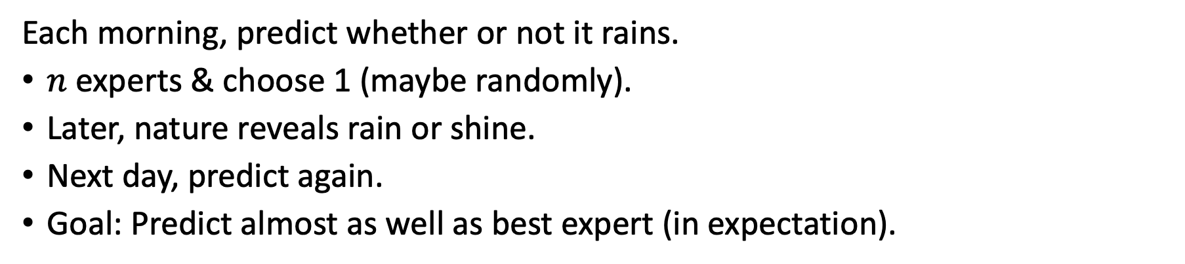
Prediction with expert advice
Each morning, predict whether or not it rains.
$n$ experts & choose 1 (maybe randomly).
Later, nature reveals rain or shine.
Next day, predict again.
Goal: Predict almost as well as best expert (in expectation).
Notes:
Imagine you wake up in the morning and what you want to predict is whether it will rain today.
So this is what you do. Imagine that you have kids at home and, in your eyes, these kids are experts. You’ll pick one of your kids, maybe randomly, and maybe some with higher probability than others.
You’ll ask your kid, is it going to rain today and the kid will say yes or no. Whatever he or she says, that’s also your guess for whether or not it will rain.
Then later in the day, nature will reveal to you whether or not it does rain.
Then the next day, you’ll repeat the process again.
What you’re trying to do is to pick your kids in such a way as to make as few mistakes as possible at least compared with the kid who is the most accurate in predicting the weather.
And you want to make your method even if nature is adversarial and even if your kids have a pact with each other or with nature to be as adversarial as possible.

Slide 5
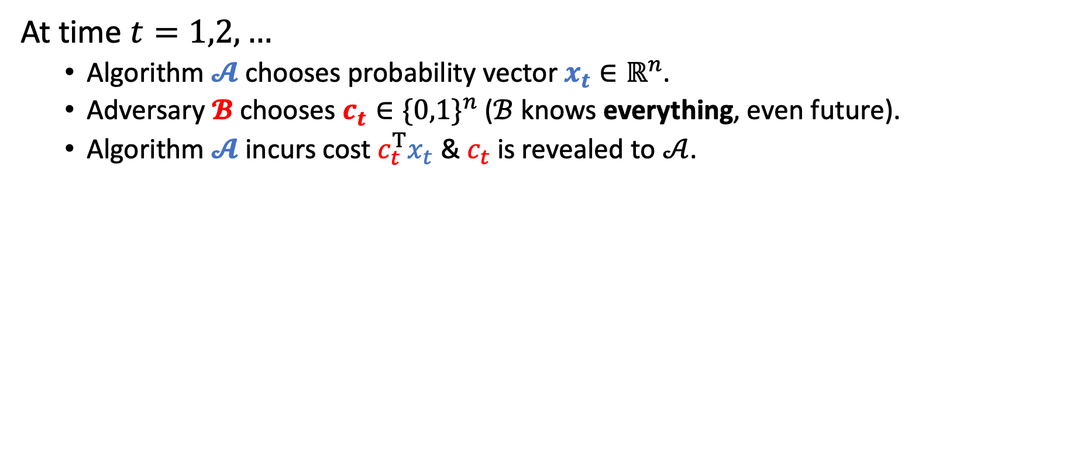
Prediction with expert advice
At time $t=1,2,…$
Algorithm $𝓐$ chooses probability vector $x_{t}∈ℝ^{n}$.
Adversary $𝓑$ chooses $c_{t}∈{\{0,1\}}^{n}$ ($ℬ$ knows everything, even future).
Algorithm $𝓐$ incurs cost $c_{t}^{T}x_{t}$ & $c_{t}$ is revealed to $𝒜$.
Notes:
Formally, the problem is as follows.
At each time step t, an algorithm chooses a probability vector x_t in R^n.
After that, an adversary chooses a cost vector c_t in R^n which is either 0 or 1. Think of 0 as being that the corresponding expert is correct, so incurs no cost, and that 1 corresponds to the expert being incorrect, so it incurs cost.
Note that I am assuming that the adversary knows everything so it is quite powerful. It knows the adversary’s probability vector and even how it will evolve over time, depending on what the adversary itself is doing.
Finally, with the algorithm having chosen his x_t and the adversary choosing costs, the algorithm incurs cost c_t^T x_t which is the probability of the algorithm being wrong. And then the entire vector c_t is revealed to the algorithm.
The algorithm’s goal is to try to minimize its regret which is defined as follows. The blue component is the expected number of mistakes that the algorithm has made up to time T and the red term is the number of mistakes, or cost, made by the best expert. So then the regret is how many more mistakes the algorithm makes (in expectation) than the best expert.
Last, I want to stress that there isn’t actually any randomness in the problem. Every quantity here is completely deterministic. The vector x_t is deterministic, the adversary’s cost is deterministic, and so on.

Slide 6
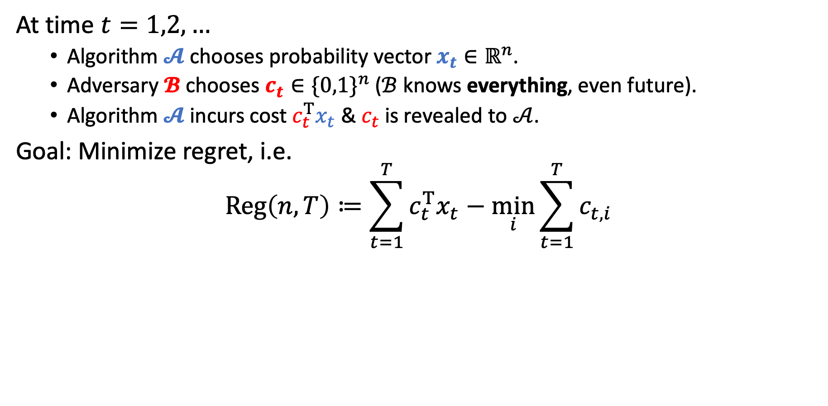
Prediction with expert advice
At time $t=1,2,…$
Algorithm $𝓐$ chooses probability vector $x_{t}∈ℝ^{n}$.
Adversary $𝓑$ chooses $c_{t}∈{\{0,1\}}^{n}$ ($ℬ$ knows everything, even future).
Algorithm $𝓐$ incurs cost $c_{t}^{T}x_{t}$ & $c_{t}$ is revealed to $𝒜$.
Goal: Minimize regret, i.e.
$$Reg\left(n,T\right)≔\sum_{t=1}^{T}{c_{t}^{T}x_{t}}−\min_{i}{\sum_{t=1}^{T}{c_{t,i}}}$$
Algorithm’s cost
Cost of best expert
Note. There is no randomness in the problem.
Notes:
Formally, the problem is as follows.
At each time step t, an algorithm chooses a probability vector x_t in R^n.
After that, an adversary chooses a cost vector c_t in R^n which is either 0 or 1. Think of 0 as being that the corresponding expert is correct, so incurs no cost, and that 1 corresponds to the expert being incorrect, so it incurs cost.
Note that I am assuming that the adversary knows everything so it is quite powerful. It knows the adversary’s probability vector and even how it will evolve over time, depending on what the adversary itself is doing.
Finally, with the algorithm having chosen his x_t and the adversary choosing costs, the algorithm incurs cost c_t^T x_t which is the probability of the algorithm being wrong. And then the entire vector c_t is revealed to the algorithm.
The algorithm’s goal is to try to minimize its regret which is defined as follows. The blue component is the expected number of mistakes that the algorithm has made up to time T and the red term is the number of mistakes, or cost, made by the best expert. So then the regret is how many more mistakes the algorithm makes (in expectation) than the best expert.
Last, I want to stress that there isn’t actually any randomness in the problem. Every quantity here is completely deterministic. The vector x_t is deterministic, the adversary’s cost is deterministic, and so on.

Slide 7
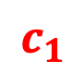
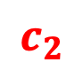
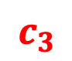
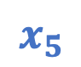
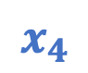



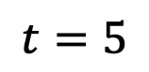
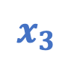
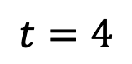
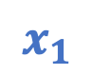
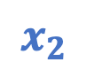
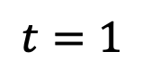
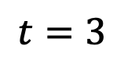
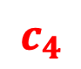
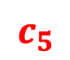
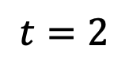

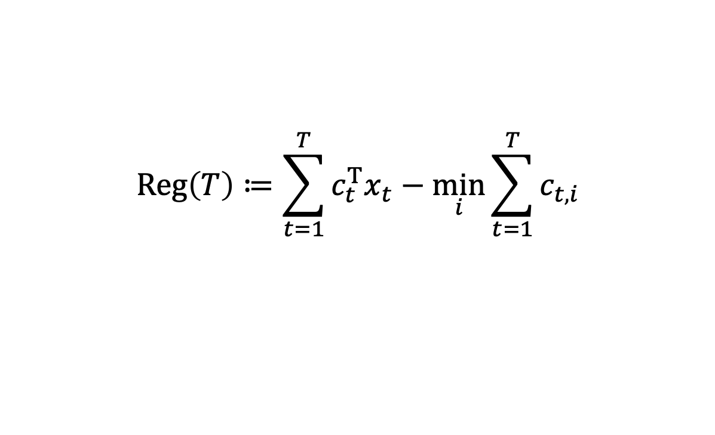



Example
$$Reg\left(T\right)≔\sum_{t=1}^{T}{c_{t}^{T}x_{t}}−\min_{i}{\sum_{t=1}^{T}{c_{t,i}}}$$
Follow best expert?
$$t=1$$
$$t=2$$
$$t=3$$
$$t=4$$
$$t=5$$
$$x_{1}$$
$$c_{1}$$
$$x_{2}$$
$$c_{2}$$
$$x_{3}$$
$$c_{3}$$
$$x_{4}$$
$$c_{4}$$
$$x_{5}$$
$$c_{5}$$
0.5
$$1$$
0.0
$$0$$
0.5
$$0$$
1.0
$$1$$
0.5
$$1$$
0.5
$$0$$
1.0
$$1$$
0.5
$$1$$
0.0
$$0$$
0.5
$$0$$
Algorithm
0.5
1.5
2
3
3.5
Best Expert
0
1
1
2
2
Regret
0.5
0.5
1.0
1.0
1.5
Notes:
Let’s do an example of this with two experts. So initially, both experts have cost 0 and are equally good. So you should really place 50/50 since you have no data. So now suppose the top expert is wrong and incurs cost 1 and the bottom is right and incurs no cost. So you incur cost 0.5 and regret is 0.5.
Now a natural thing you might try is to always follow the best expert. So let’s do this. You know place all your trust on the bottom expert. But the adversary knows this and says that that expert is wrong.
Continue example….

Slide 8
Example
$$Reg\left(T\right)≔\sum_{t=1}^{T}{c_{t}^{T}x_{t}}−\min_{i}{\sum_{t=1}^{T}{c_{t,i}}}$$
Follow best expert?
$$t=1$$
$$t=2$$
$$t=3$$
$$t=4$$
$$t=5$$
$$x_{1}$$
$$c_{1}$$
$$x_{2}$$
$$c_{2}$$
$$x_{3}$$
$$c_{3}$$
$$x_{4}$$
$$c_{4}$$
$$x_{5}$$
$$c_{5}$$
0.5
$$1$$
0.0
$$0$$
0.5
$$0$$
1.0
$$1$$
0.5
$$1$$
0.5
$$0$$
1.0
$$1$$
0.5
$$1$$
0.0
$$0$$
0.5
$$0$$
Following best expert can make regret grow linearly.
Algorithm
0.5
1.5
2
3
3.5
Best Expert
0
1
1
2
2
Regret
0.5
0.5
1.0
1.0
1.5
Notes:
What I want to observe is that, with this adversary, every time the two experts are the same, the regret increases by ½ and so the regret is linear in the number of time steps.

Slide 9
Example
$$Reg\left(T\right)≔\sum_{t=1}^{T}{c_{t}^{T}x_{t}}−\min_{i}{\sum_{t=1}^{T}{c_{t,i}}}$$
A little hedging…
$$t=1$$
$$t=2$$
$$t=3$$
$$t=4$$
$$t=5$$
$$x_{1}$$
$$c_{1}$$
$$x_{2}$$
$$c_{2}$$
$$x_{3}$$
$$c_{3}$$
$$x_{4}$$
$$c_{4}$$
$$x_{5}$$
$$c_{5}$$
0.5
$$1$$
0.4
$$0$$
0.5
$$0$$
0.6
$$1$$
0.5
$$1$$
0.5
$$0$$
0.6
$$1$$
0.5
$$1$$
0.4
$$0$$
0.5
$$0$$
Algorithm
0.5
1.1
1.6
2.2
2.7
Best Expert
0
1
1
2
2
Regret
0.5
0.1
0.6
0.2
0.7
Notes:
Actually, you can do better if you decide to hedge a little bit.
In fact, you can obtain regret that scales as the square root of time and not linearly in time.

Slide 10

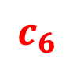
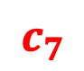
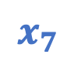
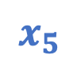
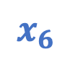
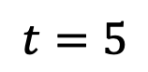
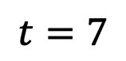
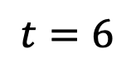
Example
$$Reg\left(T\right)≔\sum_{t=1}^{T}{c_{t}^{T}x_{t}}−\min_{i}{\sum_{t=1}^{T}{c_{t,i}}}$$
A little hedging…
$$t=5$$
$$t=6$$
$$t=7$$
$$x_{5}$$
$$c_{5}$$
$$x_{6}$$
$$c_{6}$$
$$x_{7}$$
$$c_{7}$$
0.5
$$1$$
0.4
$$1$$
0.4
$$0$$
0.5
$$0$$
0.6
$$1$$
0.6
$$0$$
Algorithm
2.7
3.7
3.7
Best Expert
2
3
3
Regret
0.7
0.7
0.7
Notes:
I just want to do two more examples. Imagine that both experts are wrong. In which case, the regret does not change. This is like wasting time.

Slide 11
An abridged history
Problem dates back to 1950s; studied in Bayesian settings [Hannan, Robbins ‘55; Blackwell ICM‘54, ‘56; Hannan ‘57, etc.]
Multiplicative weights update algorithm [Littlestone, Warmuth ‘94; Vovk ‘91; DeSantis, Markowsky, Wegman ‘88; Cesa-Bianchi et al. ‘97]
Applications
Finance (universal portfolio) [Cover ‘91; Blum, Kalai ‘99; Kalai, Vempala ‘02]
Game theory (two player zero-sum games) [Blackwell ‘56; Hannan ‘57; Foster, Vohra ‘99; Freund, Schapire ‘99]
Information theory & coding theory [Cover ‘65, ‘74; Feder ‘91; Feder, Merhav, Gutman ‘92]
Notes:
Blackwell was looking at generalizations of von Neumann’s minimax for vector-valued playoffs.
Hannan was looking at the two-player zero-sum games.
DeSantis actually had something that looked like MWU in their paper
Universal portfolio: aim to do as well as the single best stock in your portfolio

Slide 12
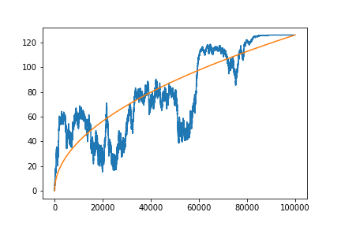
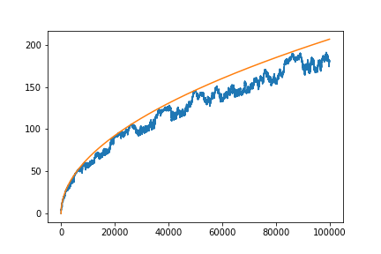

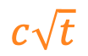

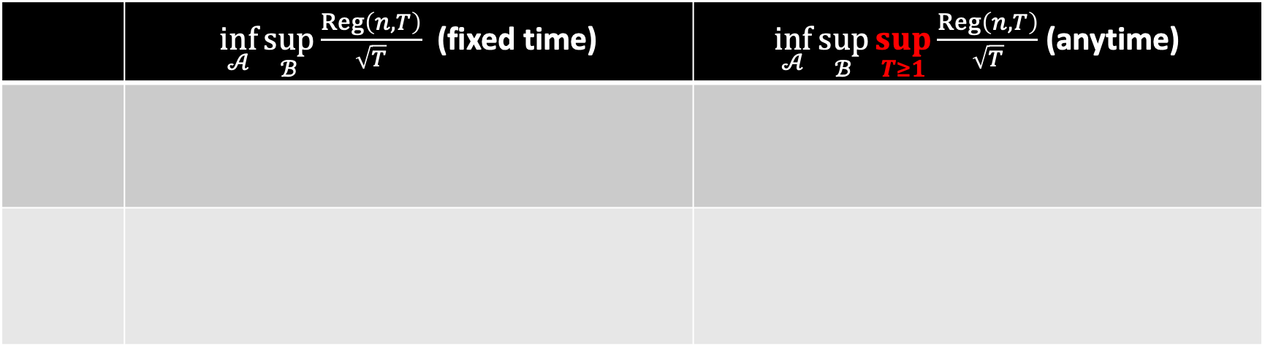

Known results
 | $\inf_{𝒜}{\sup_{ℬ}{\frac{Reg\left(n,T\right)}{\sqrt{T}}}}$ (fixed time) | $\inf_{𝒜}{\sup_{ℬ}{\sup_{T≥1}{\frac{Reg\left(n,T\right)}{\sqrt{T}}}}}$ (anytime)
$$c\sqrt{t}$$
$$c\sqrt{t}$$
$$Reg\left(t\right)$$
$$Reg\left(t\right)$$
Notes:
Split it up into upper and lower bound.

Slide 13
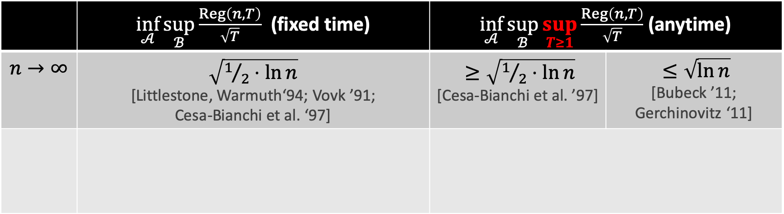
Known results
 | $\inf_{𝒜}{\sup_{ℬ}{\frac{Reg\left(n,T\right)}{\sqrt{T}}}}$ (fixed time) | $\inf_{𝒜}{\sup_{ℬ}{\sup_{T≥1}{\frac{Reg\left(n,T\right)}{\sqrt{T}}}}}$ (anytime)
$$n→∞$$ | $\sqrt{1/2⋅ln{n}}$ [Littlestone, Warmuth‘94; Vovk ’91; Cesa-Bianchi et al. ‘97] | $≥\sqrt{1/2⋅\ln{n}}$ [Cesa-Bianchi et al. ’97] | $≤\sqrt{\ln{n}}$ [Bubeck ’11; Gerchinovitz ‘11]
$$c\sqrt{t}$$
$$c\sqrt{t}$$
$$Reg\left(t\right)$$
$$Reg\left(t\right)$$
Notes:
Now I will go over some known results for this.
First, I will assume that n is large. Then in the fixed time setting, it is known that there is an algorithm whose rescale scales as this constant, sqrt(1/2 * ln(n)) multiplied by square T.
So if you look at the picture on the LHS, what I’m saying is that if you drive a square root t curve with the constant being sqrt(1/2 * ln(n)) then there is an algorithm, which knows how many steps it’s going to play and at the very end of the game, its regret will be upper bounded by this curve. And I stress that the algorithm knows exactly how many steps that it is going to play and there is no guarantee on what the regret is like before the end time. So here, in the picture, the regret may be quite poor, even initially.
It also turns out that this is tight. So if you have any algorithm, you can always force the algorithm to have this regret at the end.
A more difficult setting is what we can the anytime setting. And the goal here is to obtain a good regret bound at every single point in time and not just at the single endpoint of the game.
So in the picture on the right, I drew a square root t curve and the goal is to ensure that the regret is always below that curve even when the costs are completely adversarial.
So here it’s known that you can’t take the constant any smaller than sqrt(1/2 * ln(n)). And this follows from the fixed time guarantee because if you can’t control even knowing when the game is going to stop then you can’t control is when you don’t know when or if the game will stop.
On the other hand, if you make the curve slightly bigger, say sqrt(ln(n)) then you can ensure the regret is bounded below that curve for all times.
So in the anytime setting, there is a gap, which has existed for over 20 years.

Slide 14
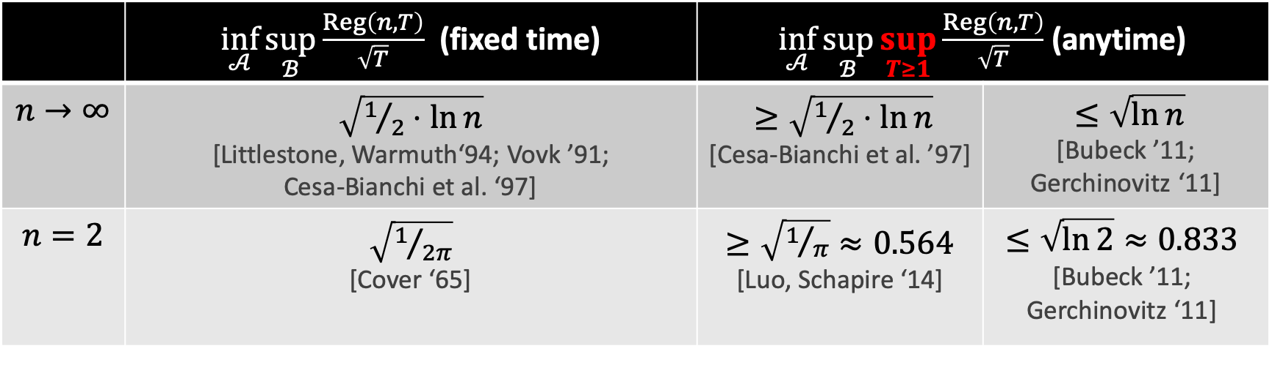
Known results
 | $\inf_{𝒜}{\sup_{ℬ}{\frac{Reg\left(n,T\right)}{\sqrt{T}}}}$ (fixed time) | $\inf_{𝒜}{\sup_{ℬ}{\sup_{T≥1}{\frac{Reg\left(n,T\right)}{\sqrt{T}}}}}$ (anytime)
$$n→∞$$ | $\sqrt{1/2⋅ln{n}}$ [Littlestone, Warmuth‘94; Vovk ’91; Cesa-Bianchi et al. ‘97] | $≥\sqrt{1/2⋅\ln{n}}$ [Cesa-Bianchi et al. ’97] | $≤\sqrt{\ln{n}}$ [Bubeck ’11; Gerchinovitz ‘11]
$$n=2$$ | $\sqrt{1/{2π}}$ [Cover ‘65] | $≥\sqrt{1/π}≈0.564$ [Luo, Schapire ‘14] | $$≤\sqrt{\ln{2}}≈0.833$$ [Bubeck ’11; Gerchinovitz ‘11]
$$c\sqrt{t}$$
$$c\sqrt{t}$$
$$Reg\left(t\right)$$
$$Reg\left(t\right)$$
Notes:
The previous results were for large n. In other words, when the number of experts are very large.
For smaller number of experts, the problem is still very interesting.
Thomas Cover, in 1965. showed that you can get regret scaling like sqrt(T/2*pi) and he also showed that this is optimal. But this assumes that the time horizon is known in advanced. So the algorithm must know how many steps are played in advance AND we care only about the regret at one specific point in time.
For the anytime, setting, Luo and Schapire showed that one can always force regret about sqrt(t/pi). So if you draw a sqrt(t/pi) curve, an algorithm can force the algorithm to exceed that curve at some time.
On the other hand, the sqrt(ln(n)) actually holds for all values for n so it holds for n = 2 as well.

Slide 15
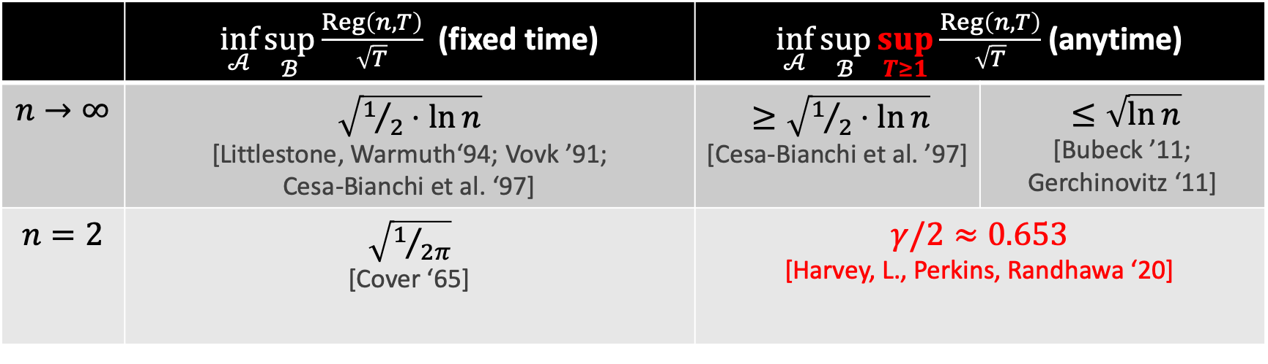
Known results
 | $\inf_{𝒜}{\sup_{ℬ}{\frac{Reg\left(n,T\right)}{\sqrt{T}}}}$ (fixed time) | $\inf_{𝒜}{\sup_{ℬ}{\sup_{T≥1}{\frac{Reg\left(n,T\right)}{\sqrt{T}}}}}$ (anytime)
$$n→∞$$ | $\sqrt{1/2⋅ln{n}}$ [Littlestone, Warmuth‘94; Vovk ’91; Cesa-Bianchi et al. ‘97] | $≥\sqrt{1/2⋅\ln{n}}$ [Cesa-Bianchi et al. ’97] | $≤\sqrt{\ln{n}}$ [Bubeck ’11; Gerchinovitz ‘11]
$$n=2$$ | $\sqrt{1/{2π}}$ [Cover ‘65] | $γ/2≈0.653$ [Harvey, L., Perkins, Randhawa ‘20]
$$c\sqrt{t}$$
$$c\sqrt{t}$$
$$Reg\left(t\right)$$
$$Reg\left(t\right)$$
Notes:
Our main result is to close the gap for n = 2 experts and we show that the minimax regret is gamma/2 * sqrt(t).
Here, gamma is a constant that I will explain on the next slide but gamma / 2 is approximately 0.653.
I want to stress that the point is not necessarily to just get better constants.
Really, we want to better understand what are some of the fundamental ideas that underlie the optimal algorithms and the optimal regret.
In fact, all the tight results are naturally related to random walks.
In the fixed time setting, the quantities are related to random walks of a fixed length.
The constant gamma for our result is actually related to random walks hitting a certain boundary similar to the picture I drew.
Maybe you can hint towards the big picture on slide 14 too: the goal is not really to say that 0.65 is better than 0.83, the goal is to understand the fundamental ideas that underlie the optimal numbers. With Cover, the optimal number comes from properties of random walks of length T. With us, the optimal number also comes from random walks / Brownian motion, but uncovering that number is a bit more complicated because you have to solve a stochastic calculus problem.

Slide 16
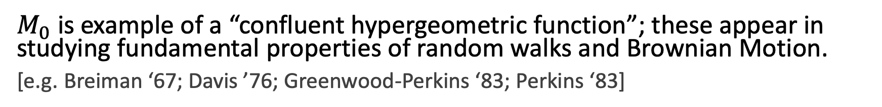
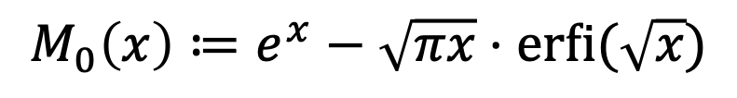
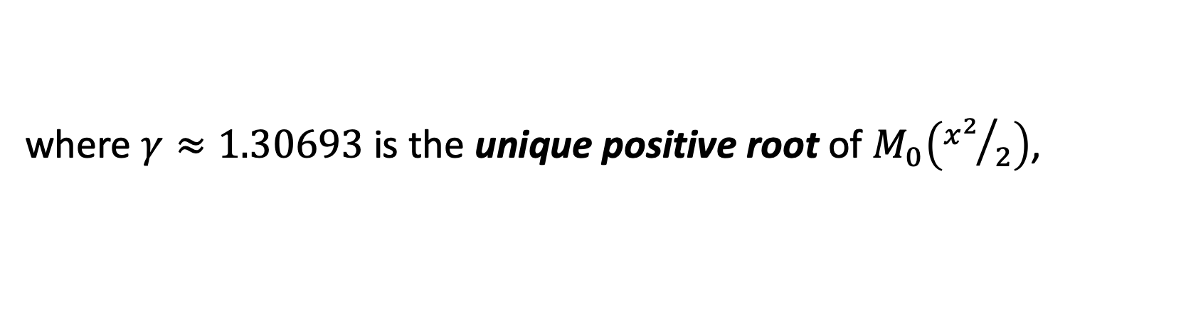
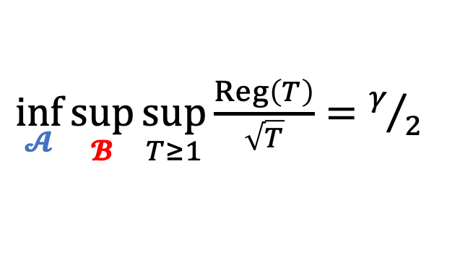
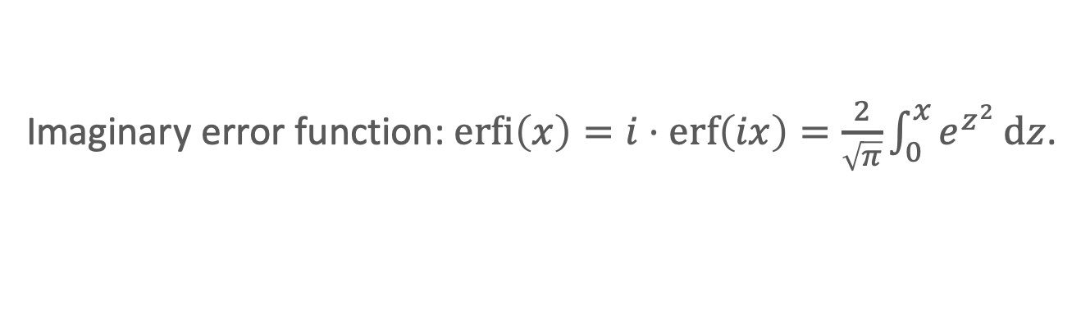
Our result
Imaginary error function: $\operatorname{erfi}\left(x\right)=i⋅erf\left(ix\right)=\frac{2}{\sqrt{π}}\int_{0}^{x}{e^{z^{2}}}dz$.
Theorem [HLPR ‘20]
For $n=2$ experts:
$\inf_{𝓐}{\sup_{𝓑}{\sup_{T≥1}{\frac{Reg\left(T\right)}{\sqrt{T}}}}}=γ/2$
where $γ≈1.30693$ is the unique positive root of $M_{0}\left({x^{2}}/2\right)$,
$$M_{0}\left(x\right)≔e^{x}−\sqrt{πx}⋅\operatorname{erfi}{(\sqrt{x}})$$
$M_{0}$ is example of a “confluent hypergeometric function”; these appear in studying fundamental properties of random walks and Brownian Motion.
[e.g. Breiman ‘67; Davis ’76; Greenwood-Perkins ‘83; Perkins ‘83]
Today: we focus on the algorithm; its design involves stochastic calculus, PDEs, & confluent hypergeometric functions.
Notes:
So our main result is as follows.
For n = 2 results, the optimal regret when appropriately scaled down by sqrt(T) is exactly gamma / 2.
In other words, there is an algorithm that achieves this regret bound and no algorithm can do better at least, not against a really bad adversary.
So what is this gamma? This gamma turns out to be the root the function M0(x^2/2) where M0 is defined by this expression. So it is e^x – sqrt(pi*x)*erfi(sqrt(x)) where erfi is the imaginary error function.
This seems like an extremely bizarre function and, in fact, the first time I saw this function, I was thinking I should probably write to Wolfram Alpha and tell them there was a bug in their software.
But actually this function turns out to be quite natural. It’s actually an example of a confluent hypergeometric function and when you start studying really fundamental properties of random walks and Brownian Motion, these functions come out as natural solutions to certain PDEs. For example, if you look at classical papers of Leo Breiman, Burgess Davis, or even Ed Perkins and Cindy Greenwood over in math and stats, you will see confluent hypergeometric functions come up. In fact, we do make of use of these results in proving the lower bound but I won’t be talking about that today.
One more thing: the function M0 will not make an appearance in the rest of my talk so you don’t have to worry about remembering it.
Good, so now I will tell you a little bit about how we design and analyze the algorithm. And I want to note that it’s a completely combinatorial and discrete problem.
On the other hand, we will make use of continuous-time stochastic calculus and PDEs to design the algorithm.

Slide 17
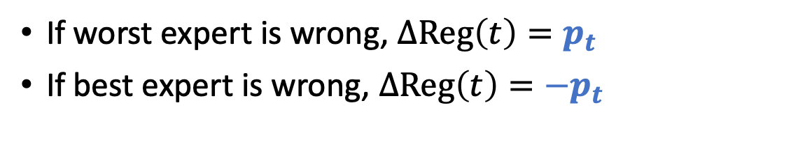
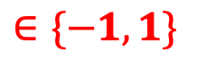
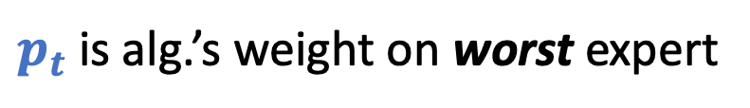
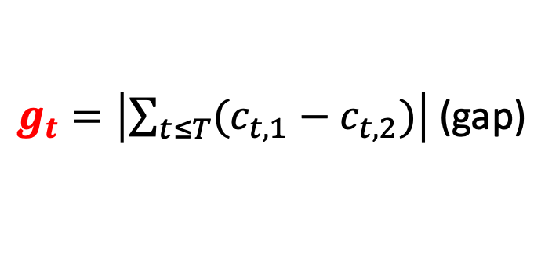
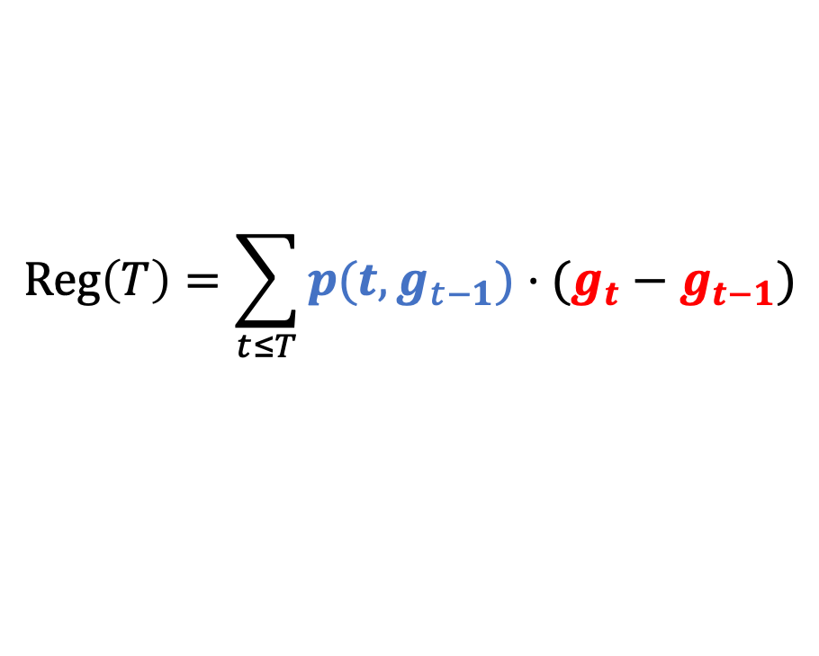
Regret as a stochastic integral
Discrete regret for two experts.
$$Reg\left(T\right)=\sum_{t≤T}{p(t,g_{t−1})⋅(g_{t}−g_{t−1})}$$
$g_{t}=\left|\sum_{t≤T}{(c_{t,1}−c_{t,2})}\right|$ (gap)
$$∈\{−1,1\}$$
$p_{t}$ is alg.’s weight on worst expert
If worst expert is wrong, $ΔReg\left(t\right)=p_{t}$
If best expert is wrong, $ΔReg\left(t\right)={−p}_{t}$

Slide 18

Regret as a stochastic integral
Discrete regret for two experts.
$$Reg\left(T\right)=\sum_{t≤T}{p(t,g_{t−1})⋅(g_{t}−g_{t−1})}$$
$g_{t}=\left|\sum_{t≤T}{(c_{t,1}−c_{t,2})}\right|$ (gap)
$$∈\{−1,1\}$$
$p_{t}$ is alg.’s weight on worst expert
Idea. View $g_{t}$ as reflected random walk. Goal. Control $Reg\left(T\right)$ a.s.
Alg/Adv play at discrete times.

Slide 19
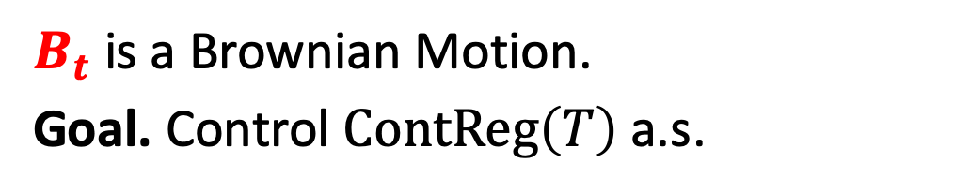
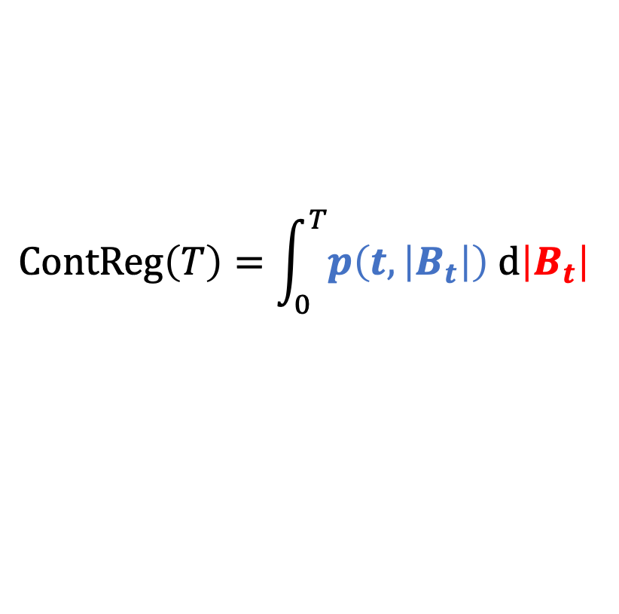
Regret as a stochastic integral
Discrete regret for two experts.
Continuous regret for two experts.
$$Reg\left(T\right)=\sum_{t≤T}{p(t,g_{t−1})⋅(g_{t}−g_{t−1})}$$
$$ContReg\left(T\right)=\int_{0}^{T}{p\left(t,\left|B_{t}\right|\right) d\left|B_{t}\right| }$$
Idea. View $g_{t}$ as reflected random walk. Goal. Control $Reg\left(T\right)$ a.s.
$B_{t}$ is a Brownian Motion.
Goal. Control $ContReg\left(T\right)$ a.s.
Alg/Adv play at discrete times.
Alg/Adv play continuously.

Slide 20
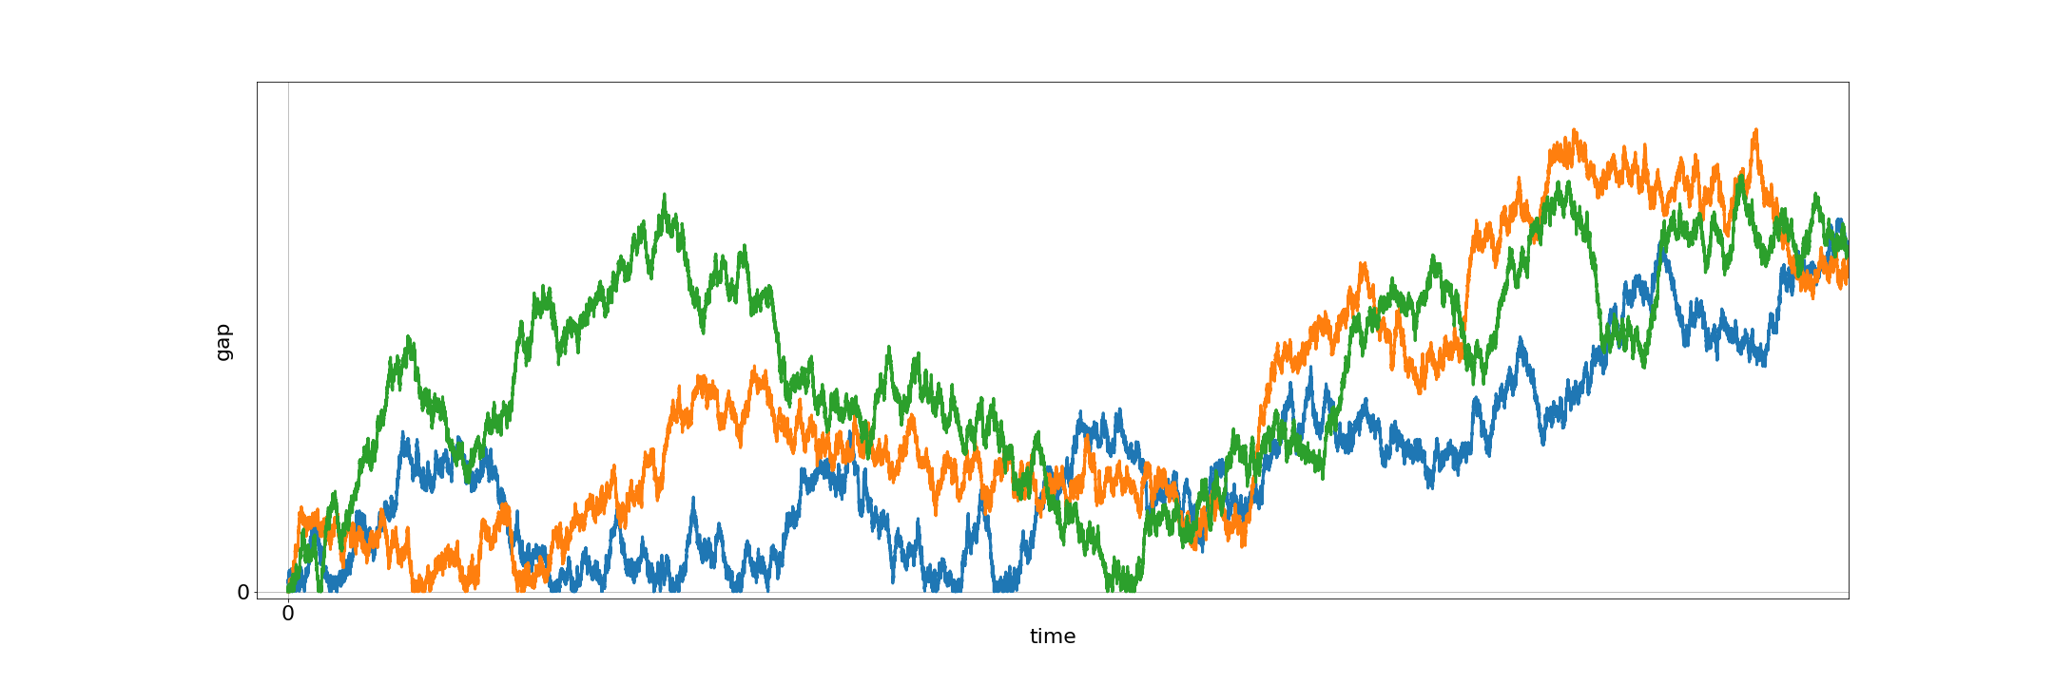
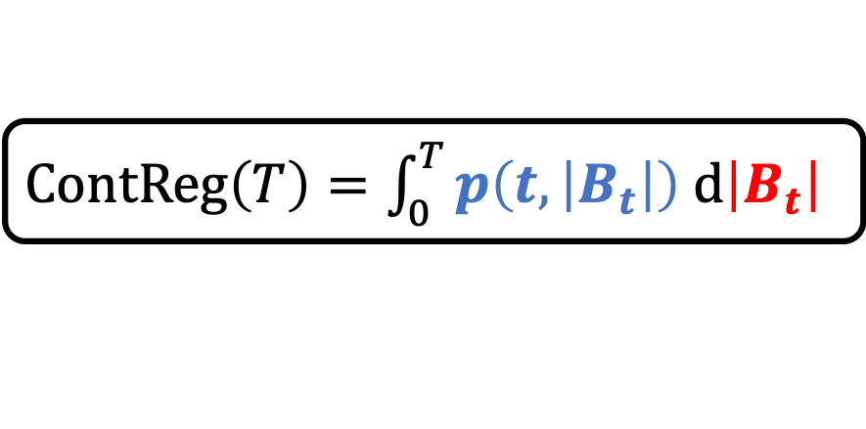
Itô and the Backwards Heat Equation
$ContReg\left(T\right)=\int_{0}^{T}{p\left(t,\left|B_{t}\right|\right) d\left|B_{t}\right| }$
Kiyoshi Itô
Key Idea. Design $p$ so that all paths have equal regret.
$$ContReg\left(T\right)≠ContReg\left(T\right)≠ContReg(T)$$

Slide 21
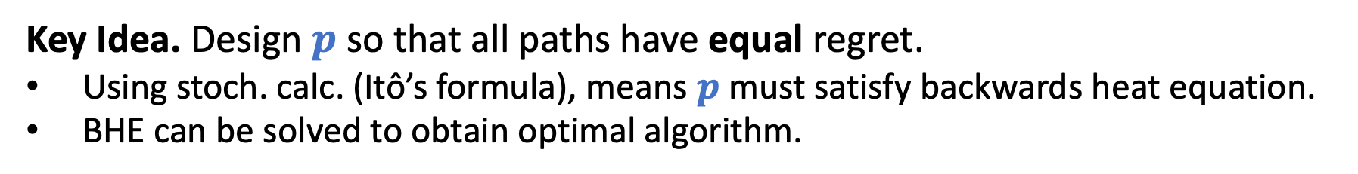
Itô and the Backwards Heat Equation
$ContReg\left(T\right)=\int_{0}^{T}{p\left(t,\left|B_{t}\right|\right) d\left|B_{t}\right| }$
Kiyoshi Itô
Key Idea. Design $p$ so that all paths have equal regret.
Using stoch. calc. (Itô’s formula), means $p$ must satisfy backwards heat equation.
BHE can be solved to obtain optimal algorithm.
Miracle. Arguments can be discretized with no loss.
$$ContReg\left(T\right)=ContReg\left(T\right)=ContReg(T)$$

Slide 22
Part 2. Sample-optimal algorithms for learning mixtures of Gaussians.
Hassan Ashtiani, Shai Ben-David, Nicholas J. A. Harvey, Christopher Liaw, Abbas Mehrabian, Yaniv Plan. Near-optimal Sample Complexity Bounds for Robust Learning of Gaussian Mixtures via Compression Schemes. Journal of the ACM. 2020.

Slide 23



Density estimation
Unknown Distribution $𝒟$
i.i.d. samples
$$\hat{𝒟}≈𝒟$$
(in $L_{1}$-distance)
Notes:
In this work, we consider the problem of density estimation which is as follows. There is an unknown distribution D which we are trying to learn and we are allowed to draw iid samples from this distribution. Our goal is to design an algorithm that takes these samples as input and outputs a distribution D hat which is close to D, say in the L1 distance.

Slide 24

Density estimation
Unknown Distribution $𝒟$
i.i.d. samples
$$\hat{𝒟}≈𝒟$$
(in $L_{1}$-distance)
Fundamental & well-studied problem with many applications!
[Feldman et al. ’06; Suresh et al. ’14; Ashtiani et al. ’17; Diakonikolas et al. ‘14-’18, etc.]
Q [D ‘16]: “For a distribution class $ℱ$, is there a complexity measure that characterizes the sample complexity of $ℱ$?”
Notes:
This is a very classical problem and has been studied for well over a century.
One of the most fundamental questions, regarding density estimation, is how many samples are needed from the distribution in order to get a good approximation its density. This is especially important when drawing samples from the unknown distribution is expensive, for example it may require sequencing a person’s genome to get a single sample. In fact, Diakonikolas posed an open problem to better understand the sample complexity of density estimation. More specifically, he asked whether there is some notion of complexity which will completely the characterize the sample complexity for various classes of distributions.
Currently, there is a growing body of work which aims to study the exact sample complexity of some specific classes. In this work, we will look at a very fundamental one, which is mixtures of Gaussians.

Slide 25


Learning Gaussians
Single Gaussian in $ℝ^{d}$.
$O\left(\frac{d^{2}}{ε^{2}}\right)$ samples are sufficient to
recover Gaussian up to $L_{1}$-error $ε$.
Notes:
So let's start off with the simplest setting which is just a single Gaussian in d dimensions.
Here, there is a very simple algorithm to estimate the density.
Given some error parameter eps, we can obtain d^2 / eps^2 samples from the distribution and then compute the sample mean and the sample covariance matrix. This is guaranteed to recover a good approximation to the Gaussian with high probability.
Actually, the bound is very intuitive as a Gaussian has d^2 parameters and one needs something like a 1/eps^2 to account for the sampling error. So the sample complexity for learning a Gaussian is upper bounded by the number of parameters that it has.

Slide 26

Learning Gaussians
Single Gaussian in $ℝ^{d}$.
$O\left(\frac{d^{2}}{ε^{2}}\right)$ samples are sufficient to
recover Gaussian up to $L_{1}$-error $ε$.
Mixture of $k$ Gaussians in $ℝ^{d}$.
Q: Are $O\left(\frac{{kd}^{2}}{ε^{2}}\right)$ samples sufficient?
Know that $\tilde{O}\left(\frac{{kd}^{2}}{ε^{4}}\right)$ are sufficient. [Ashtiani et al. ‘17]
Note: We aim to recover density, not parameters of the mixture.
Notes:
Now what about mixtures of k Gaussians? Here, there are kd^2 parameters so if you were to guess the number of samples that are sufficient then you might guess that kd^2 / epsilon^2 samples should suffice to learn the density. Prior to our work, this question has remained unresolved and is a question that we address in our work. However, previous work of some of my coauthors got close to this bound but with a suboptimal dependence on epsilon.

Slide 27
Main contribution
“Other things being equal, simpler explanations are generally better…” [William of Ockham]
One manifestation of this in learning theory is “sample compression”.
[e.g. Littlestone, Warmuth ‘86; Moran, Yehudayoff ‘16]
Notes:
Motivated by the gap in our understanding for learning mixtures of Gaussian, our main contribution in this work is to introduce a new tool for density estimation. One of the philosophical inspirations for this tool is the idea of Occam's razor. That is, all else being equal, if there are multiple explanations for some phenomenon, one ought to go with the explanation that is simpler or that is shorter.
This ideology has had many manifestations in learning theory and one such example is the notion of sample compression introduced by Littlestone and Warmuth for classification theory.

Slide 28
Main contribution
“Other things being equal, simpler explanations are generally better…” [William of Ockham]
One manifestation of this in learning theory is “sample compression”.
[e.g. Littlestone, Warmuth ‘86; Moran, Yehudayoff ‘16]
We introduce a simple & sample-efficient technique for density estimation via compression schemes.
Notes:
In this work, we introduce a new notion of compression that is tailored for density estimation. We then use compression to obtain framework for density estimation that is simple to use can can be quite sample-efficient as well.

Slide 29


Main contribution
“Other things being equal, simpler explanations are generally better…” [William of Ockham]
One manifestation of this in learning theory is “sample compression”.
[e.g. Littlestone, Warmuth ‘86; Moran, Yehudayoff ‘16]
We introduce a simple & sample-efficient technique for density estimation via compression schemes.
Application: $\tilde{O}\left({kd}^{2}/ε^{2}\right)$ samples to learn mixtures of $k$ Gaussians in $ℝ^{d}$.
We also show nearly-matching lower bound of $\tilde{Ω}\left({kd}^{2}/ε^{2}\right)$.
*Note: $\tilde{O}$ and $\tilde{Ω}$ hide $polylog(kd/ε)$ factors.
Notes:
The main application of this framework is an improved sample complexity upper bound for learning mixtures of k Gaussians in d dimensions. In fact, using this technique allowed us to show that kd^2 / epsilon^2 samples suffice to learn the density up to some small error. We also complement this with a nearly-matching lower bound. Just a reminder, the tilde on top of the Os and Omegas hides polylog(kd/eps) factors.

Slide 30




Compression Gaussians in $ℝ$
$$𝒩\left(μ, σ^{2}\right)$$
$$μ−σ$$
$$μ$$
$$μ+σ$$
Notes:
Let’s talk about compression and let’s start with an example. Here I have a Gaussian distribution with an unknown mean mu and unknown variance sigma squared. In the compression framework, we first begin by drawing a small number of points.

Slide 31
Compression Gaussians in $ℝ$
$$𝒩\left(μ, σ^{2}\right)$$
$$μ−σ$$
$$μ$$
$$μ+σ$$
Notes:
Once we draw a small number of points, the goal of compression is to try to encode the distribution with as few of these samples as possible.

Slide 32





Compression Gaussians in $ℝ$
$$𝒩\left(μ, σ^{2}\right)$$
$$X_{1}$$
$$X_{2}$$
$$μ−σ$$
$$μ$$
$$μ+σ$$
$$\frac{X_{2}+X_{1}}{2}≈μ$$
$$\frac{X_{2}−X_{1}}{2}≈σ$$
Two samples are sufficient to encode $𝒩\left(μ, σ^{2}\right)$.
Notes:
Here is one possibility. We can observe that given a moderate number of samples, there will be a point that is really close to mu – sigma and a point that is close to mu + sigma. So if we single out these two points, the observation is that the mean of these two points is approximately equal to the mean of the Gaussian. Moreover the distance between those points divided by 2 is approximately equal to the standard deviation.
So once you draw a modest number of samples from the true distribution then only two points are required to encode the actual distribution.

Slide 33






Compression framework
$ℱ$: a class of densities (e.g. Gaussians)
$m$ i.i.d. samples
from $f∈ℱ$
$t$ points
reconstruct
$$\hat{f}≈f$$
Knows $f$, $ℱ$
Knows $ℱ$
If Alice draws $m$ samples, sends $t$ points,
and $d_{TV}\left(f,\hat{f}\right)<ε$ then $ℱ$ admits $t$-compression.

Slide 34

Compression framework
$ℱ$: a class of densities (e.g. Gaussians)
$m$ i.i.d. samples
from $f∈ℱ$
$t$ points
reconstruct
$$\hat{f}≈f$$
Knows $f$, $ℱ$
Knows $ℱ$
If Alice draws $m$ samples, sends $t$ points,
and $d_{TV}\left(f,\hat{f}\right)<ε$ then $ℱ$ admits $t$-compression.

Slide 35


Compression Theorem
Theorem [ABHLMP ‘18]
If $ℱ$ has a compression scheme of size $t$ then sample complexity to learn $ℱ$ (up to $L_{1}$-error $ε$) is
$$\tilde{O}\left(\frac{t}{ε^{2}}\right).$$
$\tilde{O}\left(∙\right)$ hides polylog factors
Small compression schemes imply
sample-efficient algorithms.
Notes:
One of the key results in our paper is the connection between compression and learnability in the density estimation setting.
What we show is that if you can design a compression scheme for the class F of size t then there is a black box that will take that compression scheme and output a density estimation algorithm that learns any distribution in F with sample complexity only t / epsilon^2 hiding some polylogarithmic factors.
To summarize, short explanations are good because they automatically give sample efficient algorithms.

Slide 36



Compression of mixtures
Cheat: assume a uniform mixture.
$$𝒩\left(μ_{3}, σ_{3}^{2}\right)$$
$$𝒩\left(μ_{1}, σ_{1}^{2}\right)$$
$$𝒩\left(μ_{2}, σ_{2}^{2}\right)$$

Slide 37
Compression of mixtures
Cheat: assume a uniform mixture.
$$𝒩\left(μ_{3}, σ_{3}^{2}\right)$$
$$𝒩\left(μ_{1}, σ_{1}^{2}\right)$$
$$𝒩\left(μ_{2}, σ_{2}^{2}\right)$$

Slide 38









Compression of mixtures
Cheat: assume a uniform mixture.
$$𝒩\left(μ_{3}, σ_{3}^{2}\right)$$
$$𝒩\left(μ_{1}, σ_{1}^{2}\right)$$
$$𝒩\left(μ_{2}, σ_{2}^{2}\right)$$
$$X_{1}$$
$$X_{2}$$
$$X_{3}$$
$$X_{4}$$
$$X_{5}$$
$$X_{6}$$
$$X_{1}≈μ_{1}−σ_{1}$$
$$X_{2}≈μ_{1}+σ_{1}$$
$$X_{3}≈μ_{2}−σ_{2}$$
$$X_{4}≈μ_{2}+σ_{2}$$
$$X_{5}≈μ_{3}−σ_{3}$$
$$X_{6}≈μ_{3}+σ_{3}$$

Slide 39

Compression of mixtures
Cheat: assume a uniform mixture.
$$𝒩\left(μ_{3}, σ_{3}^{2}\right)$$
$$𝒩\left(μ_{1}, σ_{1}^{2}\right)$$
$$𝒩\left(μ_{2}, σ_{2}^{2}\right)$$
$$X_{1}$$
$$X_{2}$$
$$X_{3}$$
$$X_{4}$$
$$X_{5}$$
$$X_{6}$$
If $ℱ$ has $t$-compression then
$k$ mixtures of $ℱ$ have $\sim kt\text{−}\text{compression}$.

Slide 40

Compression Theorem for mixtures
Theorem [ABHLMP ‘18]
If $ℱ$ has a compression scheme of size $t$ then sample complexity to learn $k$ mixtures of $ℱ$ (up to $L_{1}$-error $ε$) is
$$\tilde{O}\left(\frac{kt}{ε^{2}}\right).$$
$\tilde{O}\left(∙\right)$ hides polylog factors
Small compression schemes imply
sample-efficient algorithms for mixtures.
Notes:
Now we have two key facts about compression. First, if we can compress a class then we can compress mixtures of a class.
Moreover, if we can compress a class of distributions then we can learn that class of distributions.
So putting these two ideas together, we can say that if a class has a compression scheme of size t then we can learn distributions which are mixtures of k components from that class using only kt / epsilon^2 samples.

Slide 41






Compression scheme for Gaussians
$$X_{2}$$
To recover $𝒩\left(0, Σ\right)$, suffices to encode eigenvectors/eigenvalues of $Σ$.
Idea: Encode axes of ellipsoid using linear combination of samples.
Claim. Can encode an axis w/ $\sim d$ samples.
Total: $\sim d^{2}$ samples for all $d$ axes.
$$v_{1}$$
$$v_{2}$$
$$X_{1}$$
Ellipsoid defined by $Σ$.
Points drawn from $𝒩\left(0, Σ\right)$.

Slide 42



Application: Learning mixtures of Gaussians
Theorem [ABHLMP ‘18]
Sample complexity for learning mixtures of $k$ Gaussians in $ℝ^{d}$ up to $L_{1}$-error $ε$ is
$$\tilde{O}\left(\frac{kd^{2}}{ε^{2}}\right).$$
$\tilde{O}\left(∙\right)$ hides polylog factors
Improves upon:
$O(k^{4}d^{4}/ε^{2})$ via a VC-dimension argument
$\tilde{O}(kd^{2}/ε^{4})$ [Ashtiani, Ben-David, Mehrabian ‘17]
This is nearly-tight! We show $\tilde{Ω}\left(kd^{2}/ε^{2}\right)$ samples are necessary.
Improves on previous bound of $\tilde{Ω}\left(kd/ε^{2}\right)$[Suresh et al. NeurIPS ‘14]
Notes:
Now we have two key facts about compression. First, if we can compress a class then we can compress mixtures of a class.
Moreover, if we can compress a class of distributions then we can learn that class of distributions.
So putting these two ideas together, we can say that if a class has a compression scheme of size t then we can learn distributions which are mixtures of k components from that class using only kt / epsilon^2 samples.

Slide 43
Summary
Prediction with expert advice
Uses ideas from stochastic calculus & PDEs to design optimal algorithm for two experts.
Lower bound uses martingales, Davis’ inequality, optional stopping.
Learning mixtures of Gaussians
Illustrates compression framework to design sample-efficient algorithms for density estimation.
Upper and lower bound uses many ideas from high-dimensional probability (convex hulls of Gaussian vectors, concentration of singular values, etc.).
Notes:
Now we have two key facts about compression. First, if we can compress a class then we can compress mixtures of a class.
Moreover, if we can compress a class of distributions then we can learn that class of distributions.
So putting these two ideas together, we can say that if a class has a compression scheme of size t then we can learn distributions which are mixtures of k components from that class using only kt / epsilon^2 samples.

Slide 44

Future Work
Prediction with expert advice
Extend stochastic calculus ideas to other online learning problems.
Close the gap for $n$ experts.
Learning mixtures of Gaussians
Apply the compression technique to other natural distributions.
Faster algorithms for learning mixtures of Gaussians.
Notes:
Now we have two key facts about compression. First, if we can compress a class then we can compress mixtures of a class.
Moreover, if we can compress a class of distributions then we can learn that class of distributions.
So putting these two ideas together, we can say that if a class has a compression scheme of size t then we can learn distributions which are mixtures of k components from that class using only kt / epsilon^2 samples.

Slide 45


I am grateful to my committee...
Notes:
Now we have two key facts about compression. First, if we can compress a class then we can compress mixtures of a class.
Moreover, if we can compress a class of distributions then we can learn that class of distributions.
So putting these two ideas together, we can say that if a class has a compression scheme of size t then we can learn distributions which are mixtures of k components from that class using only kt / epsilon^2 samples.

Slide 46






& amazing co-authors, friends…
Notes:
Missing Taylor

Slide 47
Thank you!
29

Slide 48
Backup slides for prediction with expert advice

Slide 49



Itô and the Backwards Heat Equation
$ContReg\left(T\right)=\int_{0}^{T}{p\left(t,\left|B_{t}\right|\right) d\left|B_{t}\right| }$
Suppose $p(t,x)=∂_{x}R(t, x)$
Itô’s Lemma
Kiyoshi Itô
$R\left(T,\left|B_{T}\right|\right)=ContReg\left(T\right)+\int_{0}^{T}{\left(∂_{t}+1/2∂_{xx}\right)R\left(t,\left|B_{t}\right|\right) dt}$
Assuming $R\left(0,0\right)=0.$
$$ContReg\left(T\right)≠ContReg\left(T\right)≠ContReg(T)$$

Slide 50
Itô and the Backwards Heat Equation
$ContReg\left(T\right)=\int_{0}^{T}{p\left(t,\left|B_{t}\right|\right) d\left|B_{t}\right| }$
Itô’s Lemma
Kiyoshi Itô
$R\left(T,\left|B_{T}\right|\right)=ContReg\left(T\right)+\int_{0}^{T}{\left(∂_{t}+1/2∂_{xx}\right)R\left(t,\left|B_{t}\right|\right) dt}$
Path independent.
Path dependent.
$$ContReg\left(T\right)≠ContReg\left(T\right)≠ContReg(T)$$

Slide 51

Itô and the Backwards Heat Equation
$ContReg\left(T\right)=\int_{0}^{T}{p\left(t,\left|B_{t}\right|\right) d\left|B_{t}\right| }$
Itô’s Lemma
Kiyoshi Itô
$R\left(T,\left|B_{T}\right|\right)=ContReg\left(T\right)+\int_{0}^{T}{\left(∂_{t}+1/2∂_{xx}\right)R\left(t,\left|B_{t}\right|\right) dt}$
Path independent.
$=0$ (BHE)
$$ContReg\left(T\right)=ContReg\left(T\right)=ContReg(T)$$

Slide 52





Itô and the Backwards Heat Equation
$ContReg\left(T\right)=\int_{0}^{T}{p\left(t,\left|B_{t}\right|\right) d\left|B_{t}\right| }$
$R\left(T,\left|B_{T}\right|\right)=\int_{0}^{T}{∂_{x}R\left(t,\left|B_{t}\right|\right) d\left|B_{t}\right| }=ContReg\left(T\right)$
Algorithm
Kiyoshi Itô
(Assuming $\left(∂_{t}+1/2∂_{xx}\right)R=0$.)
Solving BHE gives $R(t,x)$ satisfying $R\left(t,x\right)≤γ\sqrt{t}/2$.
Miracle. This can all be discretized (discrete Itô, discrete BHE, etc.).
$$∂_{x}R\left(t,γ\sqrt{t}\right)=0$$
(no mass on very
bad expert)
$$ContReg\left(T\right)=ContReg\left(T\right)=ContReg(T)$$
$$∂_{x}R\left(t,0\right)=1/2$$
Notes:
Maybe mention here

Slide 53


Lower Bound
Theorem (LB restated)
Fix an algorithm $𝒜$. For every $ε>0$, there exists an adversary $ℬ$ such that for some $T≥1$,
$$Reg\left(T\right)≥\frac{γ−ε}{2}⋅\sqrt{T}$$
*In fact, can design $ℬ$ so that $Reg\left(T\right)≥\frac{γ−ε}{2}⋅\sqrt{T}$ infinitely often.

Slide 54










Proof of Lower Bound
Recall that
$$Reg\left(T\right)=\sum_{t≤T}{p_{t}⋅(g_{t}−g_{t−1})}$$
where $p_{t}=0.5$ when $g_{t−1}=0$
Evolve $g_{t}$ as reflected standard random walk on $ℤ_{≥0}$.
$$Reg\left(T\right)=M_{T}+A_{T}$$
Doob decomposition. $M_{T}$ a martingale.
$A_{t}−A_{t−1}=E\left[p_{t}⋅\left(g_{t}−g_{t−1}\right) | ℱ_{t−1}\right]$
($ℱ_{t−1}=σ\left(g_{1},…,g_{t−1}\right)$)
$A_{t}−A_{t−1}=p_{t}⋅E\left[\left(g_{t}−g_{t−1}\right) | ℱ_{t−1}\right]$
($p_{t}∈ℱ_{t−1}$)
$A_{t}−A_{t−1}=p_{t}⋅1[g_{t−1}=0]$
($g$ is a reflected standard RW)
$A_{t}−A_{t−1}=1/2⋅1[g_{t−1}=0]$
($p_{t}=1/2$ when $g_{t−1}=0$)
$∴A_{T}=1/2⋅\sum_{t≤T}{1\left[g_{t−1}=0\right]}=1/2⋅L_{T}$
($L_{T}$ is called local time of $g$.)
Notes:
Write Reg(T) = M_T + A_T

Slide 55






Proof of Lower Bound
Recall that
$$Reg\left(T\right)=\sum_{t≤T}{p_{t}⋅(g_{t}−g_{t−1})}$$
where $p_{t}=0.5$ when $g_{t−1}=0$
Evolve $g_{t}$ as reflected standard random walk on $ℤ_{≥0}$.
$$Reg\left(T\right)=M_{T}+1/2⋅L_{T}$$
Doob decomposition. $M_{T}$ a martingale.
$L_{T}≔\sum_{t=1}^{T}{1\left[g_{t−1}=0\right]}$ is local time of $g$.
$$=M_{T}+1/2⋅(Z_{T}+g_{T})$$
Tanaka’s Formula: $L_{T}=Z_{T}+g_{T}$;
$Z_{T}$ a martingale.
$$={\hat{M}}_{T}+1/2⋅g_{T}$$
${\hat{M}}_{T}$ a martingale w/ bounded increments;
${\hat{M}}_{T}=0$
Notes:
Write Reg(T) = M_T + A_T

Slide 56




Proof of Lower Bound
Goal: $Reg\left(T\right)≥\frac{γ−ε}{2}⋅\sqrt{T}$
Recall that
$$Reg\left(T\right)=\sum_{t≤T}{p_{t}⋅(g_{t}−g_{t−1})}$$
where $p_{t}=0.5$ when $g_{t−1}=0$
Evolve $g_{t}$ as reflected standard random walk on $ℤ_{≥0}$.
$$Reg\left(T\right)={\hat{M}}_{T}+1/2⋅g_{T}$$
${\hat{M}}_{T}$ a martingale w/ bounded increments
Consider $τ≔\inf\left\{t≥1:g_{t}≥c⋅\sqrt{t}\right\}$ for some $c>1$…
$$τ$$
Notes:
Perhaps talk about Cover’s result here since it is immediate here?

Slide 57

Proof of Lower Bound
Goal: $Reg\left(T\right)≥\frac{γ−ε}{2}⋅\sqrt{T}$
Recall that
$$Reg\left(T\right)=\sum_{t≤T}{p_{t}⋅(g_{t}−g_{t−1})}$$
where $p_{t}=0.5$ when $g_{t−1}=0$
Evolve $g_{t}$ as reflected standard random walk on $ℤ_{≥0}$.
$$Reg\left(T\right)={\hat{M}}_{T}+1/2⋅g_{T}$$
${\hat{M}}_{T}$ a martingale w/ bounded increments
Consider $τ≔\inf\left\{t≥1:g_{t}≥c⋅\sqrt{t}\right\}$ for some $c>1$…
$$E\left[Reg\left(τ\right)\right]=E\left[{\hat{M}}_{τ}\right]+1/2⋅E\left[g_{τ}\right]≥c/2⋅E[\sqrt{τ}]$$
Notes:
Perhaps talk about Cover’s result here since it is immediate here?

Slide 58



Proof of Lower Bound
Goal: $Reg\left(T\right)≥\frac{γ−ε}{2}⋅\sqrt{T}$
Recall that
$$Reg\left(T\right)=\sum_{t≤T}{p_{t}⋅(g_{t}−g_{t−1})}$$
where $p_{t}=0.5$ when $g_{t−1}=0$
Evolve $g_{t}$ as reflected standard random walk on $ℤ_{≥0}$.
$$Reg\left(T\right)={\hat{M}}_{T}+1/2⋅g_{T}$$
${\hat{M}}_{T}$ a martingale w/ bounded increments
Consider $τ≔\inf\left\{t≥1:g_{t}≥c⋅\sqrt{t}\right\}$ for some $c>1$…
$$E\left[Reg\left(τ\right)\right]=E\left[{\hat{M}}_{τ}\right]+1/2⋅E\left[g_{τ}\right]≥c/2⋅E[\sqrt{τ}]$$
(assuming optional stopping applies)
$$0$$
Why not take $c$ as large as we like?
Issue: optional stopping may not apply (and would violate known upper bounds).

Slide 59

An optional stopping theorem
Goal: $Reg\left(T\right)≥\frac{γ−ε}{2}⋅\sqrt{T}$
Theorem [Davis ‘70]
Let $M$ be a martingale such that $\left|M_{t}−M_{t−1}\right|≤K$ for all $t$.
If $E\left[\sqrt{τ}\right]<∞$ then $E\left[M_{τ}\right]=0$.
Many textbook versions of OST require stronger conditions on $τ$
(e.g. $E\left[τ\right]<∞$ or $τ≤C$ a.s.) [e.g. Klenke, Durrett]

Slide 60




An optional stopping theorem
Goal: $Reg\left(T\right)≥\frac{γ−ε}{2}⋅\sqrt{T}$
Theorem [Davis ‘70]
Let $M$ be a martingale such that $\left|M_{t}−M_{t−1}\right|≤K$ for all $t$.
If $E\left[\sqrt{τ}\right]<∞$ then $E\left[M_{τ}\right]=0$.
Q: Define $τ\left(c\right)≔\inf{\{t≥1:g_{t}≥c⋅\sqrt{t}}\}$. Compute:
$$\sup\left\{c>0:E\left[\sqrt{τ\left(c\right)}\right]<∞\right\}$$
(1)
Theorem [Breiman ‘67; Greenwood-Perkins ‘83]
$γ≈1.30693$ is the value of (1).
Conclusion: For any $c<γ$, $τ=τ\left(c\right)$
$$E\left[Reg\left(τ\right)\right]=E\left[{\hat{M}}_{τ}\right]+1/2⋅E\left[g_{τ}\right]≥c/2⋅E[\sqrt{τ}]$$
$$0$$
Notes:
Add a black square.
Maybe mention probabilistic method so that there exists an adversary.

Slide 61


Upper Bound
Theorem (UB restated)
There is an algorithm $𝒜$ such that for every adversary $ℬ$
$$Reg\left(T\right)≤\frac{γ}{2}⋅\sqrt{T}$$
$$∀T≥0$$

Slide 62




Proof of upper bound
$ContReg\left(T\right)=\int_{0}^{T}{∂_{x}R\left(t,\left|B_{t}\right|\right) d\left|B_{t}\right| }$
(Itô)
$=R\left(T,\left|B_{T}\right|\right)−\int_{0}^{T}{\left(∂_{t}+1/2∂_{xx}\right)R\left(t, \left|B_{t}\right|\right) dt}$
$$=R\left(T,\left|B_{T}\right|\right)≤γ\sqrt{T}/2$$
(BHE)
In discrete-time, define $p\left(t,g\right)≔\frac{R\left(t,g+1\right)−R\left(t,g−1\right)}{2}=R_{g}(t,g)$.
$Reg\left(T\right)=\sum_{t≤T}{R_{g}\left(t,g_{t−1}\right)⋅(g_{t}−g_{t−1})}$
(discrete Itô)
$=R\left(T,g_{T}\right)−\sum_{t≤T}{R_{t}\left(t,g_{t−1}\right)+1/2R_{gg}\left(t,g_{t−1}\right)}$
$$≤R\left(T,g_{T}\right)≤γ\sqrt{T}/2$$
(discrete BHE)

Slide 63



Davis’ Theorem
Theorem (UB restated)
There is an algorithm $𝒜$ such that for every adversary $ℬ$
$$Reg\left(T\right)≤\frac{γ}{2}⋅\sqrt{T}$$
$$∀T≥0$$
Theorem [Davis ‘76]
Let $S_{t}$ be a standard random walk. For any stopping time $τ$,
$E\left[\left|S_{τ}\right|\right]≤γE\left[\sqrt{τ}\right]$.
Proof. Assume $E\left[\sqrt{τ}\right]<∞$. Consider algorithm $𝒜$ as promised in theorem and adversary $ℬ$ as defined in LB. Then
$\frac{γ}{2}⋅\sqrt{τ}≥Reg\left(τ\right)={\hat{M}}_{τ}+1/2⋅g_{τ}$ $⇒$ $\frac{γ}{2}⋅E\left[\sqrt{τ}\right]≥1/2⋅E\left[g_{τ}\right]$
Now observe that $g_{τ}=\left|S_{τ}\right|$ in distribution.

Slide 64
Backup slides for learning mixtures of Gaussians

Slide 65


Compression Theorem
Theorem [ABHLMP ‘18] Suppose $ℱ$ admits $t$-compression.
Then sample complexity to learn $ℱ$ (up to $d_{TV}$-error $ε$) is
$$\tilde{O}\left(\frac{t}{ε^{2}}\right).$$
$\tilde{O}\left(∙\right)$ hides polylog factors
Small compression schemes imply
sample-efficient algorithms.
Minor caveat: Assumes Alice does not draw far too many samples. Usually ok.
18

Slide 66





Proof of Compression Theorem
We cannot implement Alice, but we can implement Bob!
We draw $m$ i.i.d. samples from $f$ and try all $M≤m^{t}$ possible inputs to Bob to get a data-dependent cover of $ℱ$ of size $M$.
Existence of cover follows from $t$-compression.
$m$ i.i.d. samples
from $f∈ℱ$
$$ℱ$$
$$f$$
Knows $ℱ$
19

Slide 67


Proof of Compression Theorem
We cannot implement Alice, but we can implement Bob!
We draw $m$ i.i.d. samples from $f$ and try all $M≤m^{t}$ possible inputs to Bob to get a data-dependent cover of $ℱ$ of size $M$.
Existence of cover follows from $t$-compression.
$$ℱ$$
$$f$$
$$f_{1}$$
19

Slide 68

Proof of Compression Theorem
We cannot implement Alice, but we can implement Bob!
We draw $m$ i.i.d. samples from $f$ and try all $M≤m^{t}$ possible inputs to Bob to get a data-dependent cover of $ℱ$ of size $M$.
Existence of cover follows from $t$-compression.
$$ℱ$$
$$f$$
$$f_{2}$$
19

Slide 69



Proof of Compression Theorem
We cannot implement Alice, but we can implement Bob!
We draw $m$ i.i.d. samples from $f$ and try all $M≤m^{t}$ possible inputs to Bob to get a data-dependent cover of $ℱ$ of size $M$.
Existence of cover follows from $t$-compression.
$$ℱ$$
$$f$$
$$f_{4}$$
19

Slide 70

Proof of Compression Theorem
We cannot implement Alice, but we can implement Bob!
We draw $m$ i.i.d. samples from $f$ and try all $M≤m^{t}$ possible inputs to Bob to get a data-dependent cover of $ℱ$ of size $M$.
Existence of cover follows from $t$-compression.
$$ℱ$$
$$f$$
$$f_{M}$$
19

Slide 71


Proof of Compression Theorem
We cannot implement Alice, but we can implement Bob!
We draw $m$ i.i.d. samples from $f$ and try all $M≤m^{t}$ possible inputs to Bob to get a data-dependent cover of $ℱ$ of size $M$.
Existence of cover follows from $t$-compression.
Lemma [Yatracos ’85] Suppose $f∈ℱ$ is an unknown distr. Suppose $f_{1},…,f_{M}$ are distributions such that $\min_{i}{{ d}_{TV}(f}_{i},f)≤ε$. Then sample complexity to learn is $O(\log{M/ε^{2})}$.
19

Slide 72

Proof of Compression Theorem
We cannot implement Alice, but we can implement Bob!
We draw $m$ i.i.d. samples from $f$ and try all $M≤m^{t}$ possible inputs to Bob to get a data-dependent cover of $ℱ$ of size $M$.
Existence of cover follows from $t$-compression.
Run finite cover alg. to find “best” distr. with $O\left(\log{M}/ε^{2}\right)$ samples.
Hence, sample complexity is
$m+O\left(\log{M}/ε^{2}\right)=m+O\left(t\log{m}/ε^{2}\right)$.
■
Initial samples
Samples for finite cover algorithm
Typically negligible.
(trust me)
19

Slide 73


Why total variation?
What if we wanted to focus on KL divergence instead?
Lemma. For mixtures of two Gaussians, it is impossible to have an algorithm that draws at most $M<∞$ samples from $f$ and returns $\hat{f}$ such that $KL\left(f,\hat{f}\right)≤{10}^{10}$.
*$KL\left(f,\hat{f}\right)=\int{f\left(x\right)\log{\frac{f\left(x\right)}{\hat{f}\left(x\right)}} dx}$
11

Slide 74

Why total variation?
What if we wanted to focus on KL divergence instead?
Lemma. For mixtures of two Gaussians, it is impossible to have an algorithm that draws at most $M<∞$ samples from $f$ and returns $\hat{f}$ such that $KL\left(f,\hat{f}\right)≤{10}^{10}$.
What about other $L_{p}$-norms ($p>1$)?
Lemma. For mixtures of two Gaussians, it is impossible to have an algorithm that draws at most $M<∞$ samples from $f$ and returns $\hat{f}$ such that ${\left\|f−\hat{f}\right\|}_{p}≤{10}^{10}$.
11

Slide 75


Our result
Theorem [HLPR ‘20]
For $n=2$ experts:
$\inf_{𝓐}{\sup_{𝓑}{\sup_{T≥1}{\frac{Reg\left(T\right)}{\sqrt{T}}}}}=γ/2$
where $γ≈1.30693$ is the unique positive root of $M_{0}\left({x^{2}}/2\right)$,
$$M_{0}\left(x\right)≔e^{x}−\sqrt{πx}⋅\operatorname{erfi}{(\sqrt{x}})$$
This constant $γ$ also appears in studying fundamental properties of Brownian Motion. [e.g. Davis ‘76, Greenwood-Perkins ‘83; Perkins ‘83]
Today: we focus on upper bound.

Slide 76
Outline
Part 1. Optimal anytime regret with experts.
Part 2. Sample-optimal algorithms for learning mixtures of Gaussians.

Slide 77


Regret for 2 experts
Simple expression for regret with 2 experts:
$$Reg\left(T\right)=\sum_{t≤T}{p_{t}⋅(g_{t}−g_{t−1})}$$
$g_{t}=\left|\sum_{t≤T}{(c_{t,1}−c_{t,2})}\right|$ (gap)
$p_{t}$ is alg.’s weight on worst expert
$$∈\{−1,0,1\}$$
Best expert gets cost 1.
Worst expert gets cost 1.
Equal costs on experts.
Notes:
To begin, I want to start off by asserting that for two experts, the regret has a fairly simple expression.
First, let’s define the gap between the experts. This is the absolute difference between the number of mistakes made by expert 1 and the number of mistakes made by expert 2.
So if expert 1 has made 5 mistakes and expert 2 has made 10 then the gap is 5.
Finally, I will denote by p the algorithm’s weight up on the worst expert. The algorithm’s weight on the best expert will be 1-p_t.
Also, notice that between two time steps, the gap can change by -1, 0, or +1.
It changes by 0 if the costs are equal on both experts. In other words, both experts are correct or both experts are wrong.
It is equal to 1 if the worst expert is wrong, so the difference in the number of mistakes increases by 1.
Finally, it is -1 if the best expert is wrong so the difference in the number of mistakes decreases by 1.
So what this formula is saying is that the change in regret at time t can be described as follows.
We look at how much weight we place on the worst expert. If the gap goes up, we gain that much regret.
If the gap goes down, we lose that much regret.
For example, suppose we place weight 1 on the worst expert.
If the worst expert is wrong but the best expert is correct then we will have one full mistake more than the best expert so regret increases by 1.
On the other hand, if the best expert is wrong then we will not have made any additional mistakes but the best expert will have made one more.
So the regret decreases b 1.

Slide 78


Regret for 2 experts
Simple expression for regret with 2 experts:
$$Reg\left(T\right)=\sum_{t≤T}{p_{t}⋅(g_{t}−g_{t−1})}$$
$g_{t}=\left|\sum_{t≤T}{(c_{t,1}−c_{t,2})}\right|$ (gap)
$p_{t}$ is alg.’s weight on worst expert
$$∈\{−1,1\}$$
Intuitively, $g_{t}−g_{t−1}=0$ is “wasting time”.
Notes:
Just a couple small observations. Intuitively, the adversary shouldn’t make the gap equal. It doesn’t affect the regret but time moves on. So in a sense, this is wasting the adversary’s time.

Slide 79



Regret for 2 experts
Simple expression for regret with 2 experts:
$$Reg\left(T\right)=\sum_{t≤T}{p(t,g_{t−1})⋅(g_{t}−g_{t−1})}$$
$g_{t}=\left|\sum_{t≤T}{(c_{t,1}−c_{t,2})}\right|$ (gap)
$p_{t}$ is alg.’s weight on worst expert
$$∈\{−1,1\}$$
Intuitively, $g_{t}−g_{t−1}=0$ is “wasting time” for adversary.
$p_{t}$ should be “Markovian”, i.e. depends only on state $(t,g)$.
Adversary’s path leading to $(t,g)$ reveals nothing about adversary.
Notes:
The other observation is that the algorithm should be Markovian, in the sense that it should only depend on the current time and the current gap.
The reason for this is, provided that the current gap is g, what the adversary will do to maximize regret from that point is completely independent of what it has done in the past.
Or put another way, the adversary’s path leading to a certain state, reveals nothing about the adversary whatsoever.

Slide 80









Regret for 2 experts
$$Reg\left(T\right)=\sum_{t≤T}{p(t,g_{t−1})⋅(g_{t}−g_{t−1})}$$
$$Reg\left(1\right)=0.5$$
$$p\left(2,1\right)=0.4$$
$$Reg\left(3\right)=0.6$$
$$Reg\left(0\right)=0$$
$$p\left(1,0\right)=0.5$$
$$Reg\left(2\right)=0.1$$
$$p\left(3,0\right)=0.5$$
Notes:
Okay, let me do an example and at the same time I want to illustrate a point.

Slide 81






Regret for 2 experts
$$Reg\left(T\right)=\sum_{t≤T}{p(t,g_{t−1})⋅(g_{t}−g_{t−1})}$$
$$Reg\left(2\right)=0.9$$
$$p\left(3,2\right)=0.25$$
$$Reg\left(1\right)=0.5$$
$$p\left(2,1\right)=0.4$$
$$Reg\left(3\right)=0.65$$
$$Reg\left(3\right)=0.6$$
$$Reg\left(0\right)=0$$
$$p\left(1,0\right)=0.5$$
$$Reg\left(2\right)=0.1$$
$$p\left(3,0\right)=0.5$$
Notes:
Note that we took two different paths and that we got different values for the regret despite that the final gap is the same.
Intuitively, this is a bit strange. The algorithm knows that the adversary will try to force as large regret as possible. So shouldn’t it try to be as balanced as possible? Shouldn’t it try to shift some weight away from this top path and make it seem more appealing for the algorithm but making the bottom path slightly less appealing?

Slide 82


Regret for 2 experts
Regret is inherently a path-wise quantity.
Can we design $p(t,g)$so regret is path-independent?
Can continuous viewpoint provide us more tools?
$$Reg\left(T\right)=5.6$$
$$Reg\left(T\right)=5.8$$
$$Reg\left(T\right)=6.1$$

Slide 83

Itô and the Backwards Heat Equation
$ContReg\left(T\right)=\int_{0}^{T}{p\left(t,\left|B_{t}\right|\right) d\left|B_{t}\right| }$
$R\left(T,\left|B_{T}\right|\right)=\int_{0}^{T}{∂_{x}R\left(t,\left|B_{t}\right|\right) d\left|B_{t}\right| }=ContReg\left(T\right)$
Algorithm
Kiyoshi Itô
(Assuming $\left(∂_{t}+1/2∂_{xx}\right)R=0$.)
Solving the BHE* gives a potential function such that
$R\left(t,x\right)≤γ\sqrt{t}/2$ for all $t,x≥0$.
Miracle. Continuous argument can be discretized with no loss.
(i.e. discrete Itô, discrete BHE, alg. defined by discrete derivative)
*We need boundary conditions for BHE. Optimal bound achieved by optimizing over all possible boundaries.
Notes:
Maybe mention here

Slide 84
Itô and the Backwards Heat Equation
$ContReg\left(T\right)=\int_{0}^{T}{p\left(t,\left|B_{t}\right|\right) d\left|B_{t}\right| }$
Suppose $p(t,x)=∂_{x}R(t, x)$
Itô’s Lemma
Kiyoshi Itô
$R\left(T,\left|B_{T}\right|\right)=ContReg\left(T\right)+\int_{0}^{T}{\left(∂_{t}+1/2∂_{xx}\right)R\left(t,\left|B_{t}\right|\right) dt}$
Assuming $R\left(0,0\right)=0.$
$$ContReg\left(T\right)≠ContReg\left(T\right)≠ContReg(T)$$

Slide 85
Itô and the Backwards Heat Equation
$ContReg\left(T\right)=\int_{0}^{T}{p\left(t,\left|B_{t}\right|\right) d\left|B_{t}\right| }$
Itô’s Lemma
Kiyoshi Itô
$R\left(T,\left|B_{T}\right|\right)=ContReg\left(T\right)+\int_{0}^{T}{\left(∂_{t}+1/2∂_{xx}\right)R\left(t,\left|B_{t}\right|\right) dt}$
Path independent.
Path dependent.
$$ContReg\left(T\right)≠ContReg\left(T\right)≠ContReg(T)$$

Slide 86
Itô and the Backwards Heat Equation
$ContReg\left(T\right)=\int_{0}^{T}{p\left(t,\left|B_{t}\right|\right) d\left|B_{t}\right| }$
Itô’s Lemma
Kiyoshi Itô
$R\left(T,\left|B_{T}\right|\right)=ContReg\left(T\right)+\int_{0}^{T}{\left(∂_{t}+1/2∂_{xx}\right)R\left(t,\left|B_{t}\right|\right) dt}$
Path independent.
$=0$ (BHE)
$$ContReg\left(T\right)=ContReg\left(T\right)=ContReg(T)$$

Slide 87

Itô and the Backwards Heat Equation
$ContReg\left(T\right)=\int_{0}^{T}{p\left(t,\left|B_{t}\right|\right) d\left|B_{t}\right| }$
Itô’s Lemma
(define)
Kiyoshi Itô
$R\left(T,\left|B_{T}\right|\right)=\int_{0}^{T}{∂_{x}R\left(t,\left|B_{t}\right|\right) d\left|B_{t}\right| }+\int_{0}^{T}{\left(∂_{t}+1/2∂_{xx}\right)R\left(t,\left|B_{t}\right|\right) dt}$
Path independent.
Path dependent.
$$ContReg\left(T\right)≠ContReg\left(T\right)≠ContReg(T)$$

Slide 88
Itô and the Backwards Heat Equation
$ContReg\left(T\right)=\int_{0}^{T}{p\left(t,\left|B_{t}\right|\right) d\left|B_{t}\right| }$
Itô’s Lemma
(define)
Kiyoshi Itô
$R\left(T,\left|B_{T}\right|\right)=\int_{0}^{T}{∂_{x}R\left(t,\left|B_{t}\right|\right) d\left|B_{t}\right| }+\int_{0}^{T}{\left(∂_{t}+1/2∂_{xx}\right)R\left(t,\left|B_{t}\right|\right) dt}$
Path independent.
$=0$ (BHE)
$$ContReg\left(T\right)=ContReg\left(T\right)=ContReg(T)$$

Slide 89
Itô and the Backwards Heat Equation
$ContReg\left(T\right)=\int_{0}^{T}{p\left(t,\left|B_{t}\right|\right) d\left|B_{t}\right| }$
$R\left(T,\left|B_{T}\right|\right)=\int_{0}^{T}{∂_{x}R\left(t,\left|B_{t}\right|\right) d\left|B_{t}\right| }=ContReg\left(T\right)$
Algorithm
Kiyoshi Itô
(Assuming $\left(∂_{t}+1/2∂_{xx}\right)R=0$.)
Solving BHE gives $R(t,x)$ satisfying $R\left(t,x\right)≤γ\sqrt{t}/2$.
Miracle. This can all be discretized (discrete Itô, discrete BHE, etc.).
$$∂_{x}R\left(t,γ\sqrt{t}\right)=0$$
(no mass on very
bad expert)
$$ContReg\left(T\right)=ContReg\left(T\right)=ContReg(T)$$
$$∂_{x}R\left(t,0\right)=1/2$$
Notes:
Maybe mention here

Slide 90

Itô and the Backwards Heat Equation
$ContReg\left(T\right)=\int_{0}^{T}{p\left(t,\left|B_{t}\right|\right) d\left|B_{t}\right| }$
$R\left(T,\left|B_{T}\right|\right)=\int_{0}^{T}{∂_{x}R\left(t,\left|B_{t}\right|\right) d\left|B_{t}\right| }=ContReg\left(T\right)$
Algorithm
Kiyoshi Itô
(Assuming $\left(∂_{t}+1/2∂_{xx}\right)R=0$.)
Solving the BHE* gives a potential function such that
$R\left(t,x\right)≤γ\sqrt{t}/2$ for all $t,x≥0$.
Miracle. Continuous argument can be discretized with no loss.
(recycle potential function but use discrete Itô, discrete BHE, discrete derivative, etc.)
*Solving BHE requires boundary conditions.
$∂_{x}R\left(t,x\right)=1/2$ (i.e. equally good experts)
$∂_{x}R\left(t,x\right)=0$ when $x≥γ\sqrt{t}$ (i.e. ignore expert if sufficiently poor)
Notes:
Maybe mention here

Slide 91
Summary
Discrete regret
problem
Continuous regret problem
Discrete Itô
Discrete BHE
Itô’s Lemma, BHE
Discrete
algorithm
Potential
function
Continuous
algorithm

Slide 93





Regret as a stochastic integral
Simple expression for regret with 2 experts:
$$Reg\left(T\right)=\sum_{t≤T}{p_{t}⋅(g_{t}−g_{t−1})}$$
$g_{t}=\left|\sum_{t≤T}{(c_{t,1}−c_{t,2})}\right|$ (gap)
$p_{t}$ is alg.’s weight on worst expert
$$∈\{−1,0,1\}$$
Idea. Evolve $g_{t}$ as stochastic process and control regret almost surely.
Idea. Let’s evolve $g_{t}$ as a reflected random walk.
A continuous formulation:
$$ContReg\left(T\right)=\int_{0}^{T}{p\left(t,\left|B_{t}\right|\right) d\left|B_{t}\right| }$$
$B_{t}$ is Brownian Motion.

Slide 94


Itô and the Backwards Heat Equation
$ContReg\left(T\right)=\int_{0}^{T}{p\left(t,\left|B_{t}\right|\right) d\left|B_{t}\right| }$
Kiyoshi Itô
Itô’s Lemma
$R\left(T,\left|B_{T}\right|\right)=\int_{0}^{T}{∂_{x}R\left(t,\left|B_{t}\right|\right) d\left|B_{t}\right| }+\int_{0}^{T}{\left(∂_{t}+1/2∂_{xx}\right)R\left(t,\left|B_{t}\right|\right) dt}$
Idea. Find a “good” potential function $R\left(t,x\right)$ and set alg. as $p=∂_{x}R$.
Itô’s Lemma gives formula for regret.

Slide 95


Itô and the Backwards Heat Equation
$ContReg\left(T\right)=\int_{0}^{T}{p\left(t,\left|B_{t}\right|\right) d\left|B_{t}\right| }$
Kiyoshi Itô
Itô’s Lemma
$R\left(T,\left|B_{T}\right|\right)=\int_{0}^{T}{∂_{x}R\left(t,\left|B_{t}\right|\right) d\left|B_{t}\right| }+\int_{0}^{T}{\left(∂_{t}+1/2∂_{xx}\right)R\left(t,\left|B_{t}\right|\right) dt}$
BHE (or space-time harmonic)
If $\left(∂_{t}+1/2∂_{xx}\right)R\left(t,x\right)=0$, $p≔∂_{x}R$, and $∂_{x}R\left(t,0\right)=1/2$ then
$R\left(T,\left|B_{T}\right|\right)=\int_{0}^{T}{∂_{x}R\left(t,\left|B_{t}\right|\right) d\left|B_{t}\right| }=ContReg\left(T\right)$
Key Idea. Enforce BHE so that $ContReg\left(T\right)$ is path-independent.
Notes:
Maybe mention here

Slide 96
Itô and the Backwards Heat Equation
$ContReg\left(T\right)=\int_{0}^{T}{p\left(t,\left|B_{t}\right|\right) d\left|B_{t}\right| }$
$R\left(T,\left|B_{T}\right|\right)=\int_{0}^{T}{∂_{x}R\left(t,\left|B_{t}\right|\right) d\left|B_{t}\right| }=ContReg\left(T\right)$
Algorithm
Kiyoshi Itô
(Assuming $\left(∂_{t}+1/2∂_{xx}\right)R=0$.)
Solving the BHE* gives a potential function such that
$R\left(t,x\right)≤γ\sqrt{t}/2$ for all $t,x≥0$.
Miracle. Continuous argument can be discretized with no loss.
(recycle potential function but use discrete Itô, discrete BHE, discrete derivative, etc.)
*Solving BHE requires boundary conditions.
$∂_{x}R\left(t,x\right)=1/2$ (i.e. equally good experts)
$∂_{x}R\left(t,x\right)=0$ when $x≥γ\sqrt{t}$ (i.e. ignore expert if sufficiently poor)
Notes:
Maybe mention here

Slide 97
Regret as a stochastic integral
Discrete regret for two experts:
$$Reg\left(T\right)=\sum_{t≤T}{p(t,g_{t−1})⋅(g_{t}−g_{t−1})}$$
$g_{t}=\left|\sum_{t≤T}{(c_{t,1}−c_{t,2})}\right|$ (gap)
$p_{t}$ is alg.’s weight on worst expert
$$∈\{−1,1\}$$
Idea. Evolve $g_{t}$ as stochastic process and control regret almost surely.
Idea. Let’s evolve $g_{t}$ as a reflected random walk.
A continuous formulation:
$$ContReg\left(T\right)=\int_{0}^{T}{p\left(t,\left|B_{t}\right|\right) d\left|B_{t}\right| }$$
$B_{t}$ is Brownian Motion.

Slide 98
Itô and the Backwards Heat Equation
$ContReg\left(T\right)=\int_{0}^{T}{p\left(t,\left|B_{t}\right|\right) d\left|B_{t}\right| }$
Kiyoshi Itô
Itô’s Lemma
$R\left(T,\left|B_{T}\right|\right)=\int_{0}^{T}{∂_{x}R\left(t,\left|B_{t}\right|\right) d\left|B_{t}\right| }+\int_{0}^{T}{\left(∂_{t}+1/2∂_{xx}\right)R\left(t,\left|B_{t}\right|\right) dt}$
Assuming $R\left(0,0\right)=0.$
Idea. Find a “good” potential function $R\left(t,x\right)$ and set alg. as $p=∂_{x}R$.

Slide 99
Itô and the Backwards Heat Equation
$ContReg\left(T\right)=\int_{0}^{T}{p\left(t,\left|B_{t}\right|\right) d\left|B_{t}\right| }$
Kiyoshi Itô
Itô’s Lemma
$R\left(T,\left|B_{T}\right|\right)=\int_{0}^{T}{∂_{x}R\left(t,\left|B_{t}\right|\right) d\left|B_{t}\right| }+\int_{0}^{T}{\left(∂_{t}+1/2∂_{xx}\right)R\left(t,\left|B_{t}\right|\right) dt}$
BHE (or space-time harmonic)
If $\left(∂_{t}+1/2∂_{xx}\right)R\left(t,x\right)=0$, $p≔∂_{x}R$, and $∂_{x}R\left(t,0\right)=1/2$ then
$R\left(T,\left|B_{T}\right|\right)=\int_{0}^{T}{∂_{x}R\left(t,\left|B_{t}\right|\right) d\left|B_{t}\right| }=ContReg\left(T\right)$
Key Idea. If BHE holds then $ContReg\left(T\right)$ is path-independent.
Notes:
Maybe mention here

Slide 100

Itô and the Backwards Heat Equation
$ContReg\left(T\right)=\int_{0}^{T}{p\left(t,\left|B_{t}\right|\right) d\left|B_{t}\right| }$
$R\left(T,\left|B_{T}\right|\right)=\int_{0}^{T}{∂_{x}R\left(t,\left|B_{t}\right|\right) d\left|B_{t}\right| }=ContReg\left(T\right)$
Algorithm
Kiyoshi Itô
(Assuming $\left(∂_{t}+1/2∂_{xx}\right)R=0$.)
Miracle. Solving BHE gives $R(t,x)$ satisfying $R\left(t,x\right)≤γ\sqrt{t}/2$.
Super Miracle. This can all be discretized (discrete Itô, discrete BHE, etc.).
$$∂_{x}R\left(t,γ\sqrt{t}\right)=0$$
(no mass on very
bad expert)
$$ContReg\left(T\right)=ContReg\left(T\right)=ContReg(T)$$
$$∂_{x}R\left(t,0\right)=1/2$$
Notes:
Maybe mention here

